Slide 1


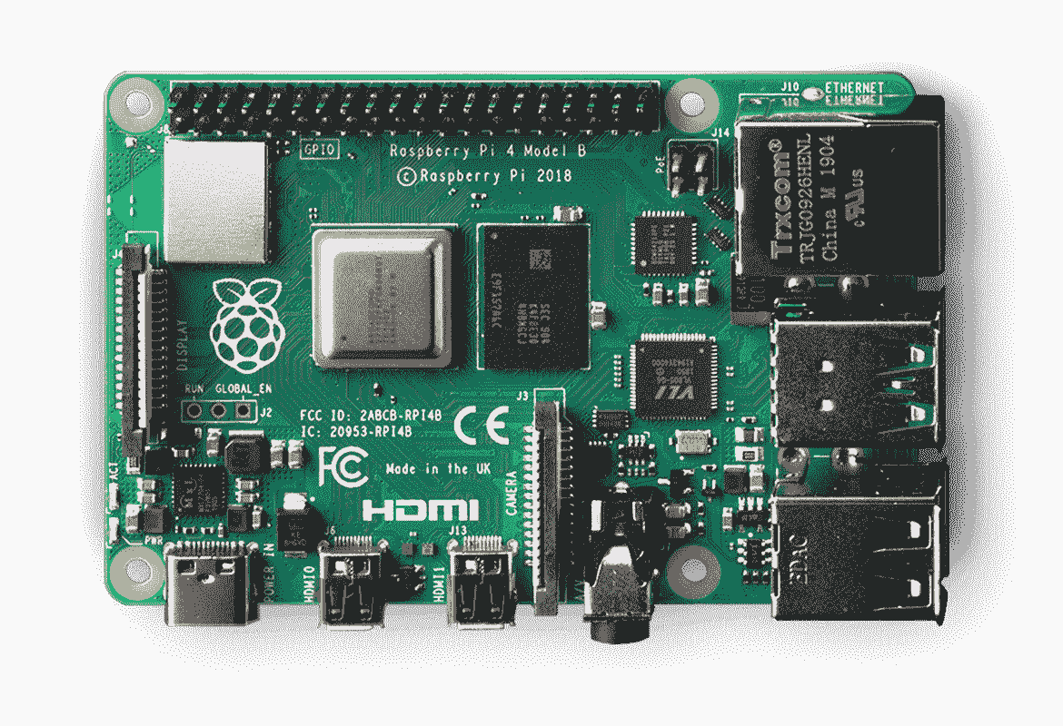





AWS Cloud
VPC
EC2 instance contents
본체(Jetson Nano $39.99)
Instance
Internet
WIFI
클라우드 서버
컨트롤러

